Slide 1
Docker
https://www.docker.com/

Slide 2
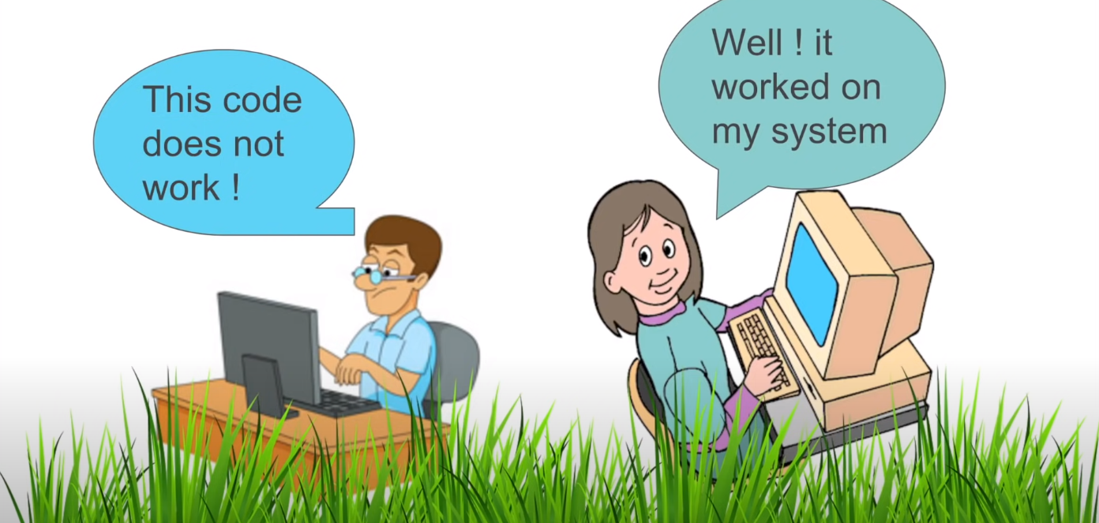
Docker Beginner Tutorial 1 - What is DOCKER (step by step) | Docker Introduction | Docker basics
https://www.youtube.com/watch?v=wi-MGFhrad0&list=PLhW3qG5bs-L99pQsZ74f-LC-tOEsBp2rK

Slide 3
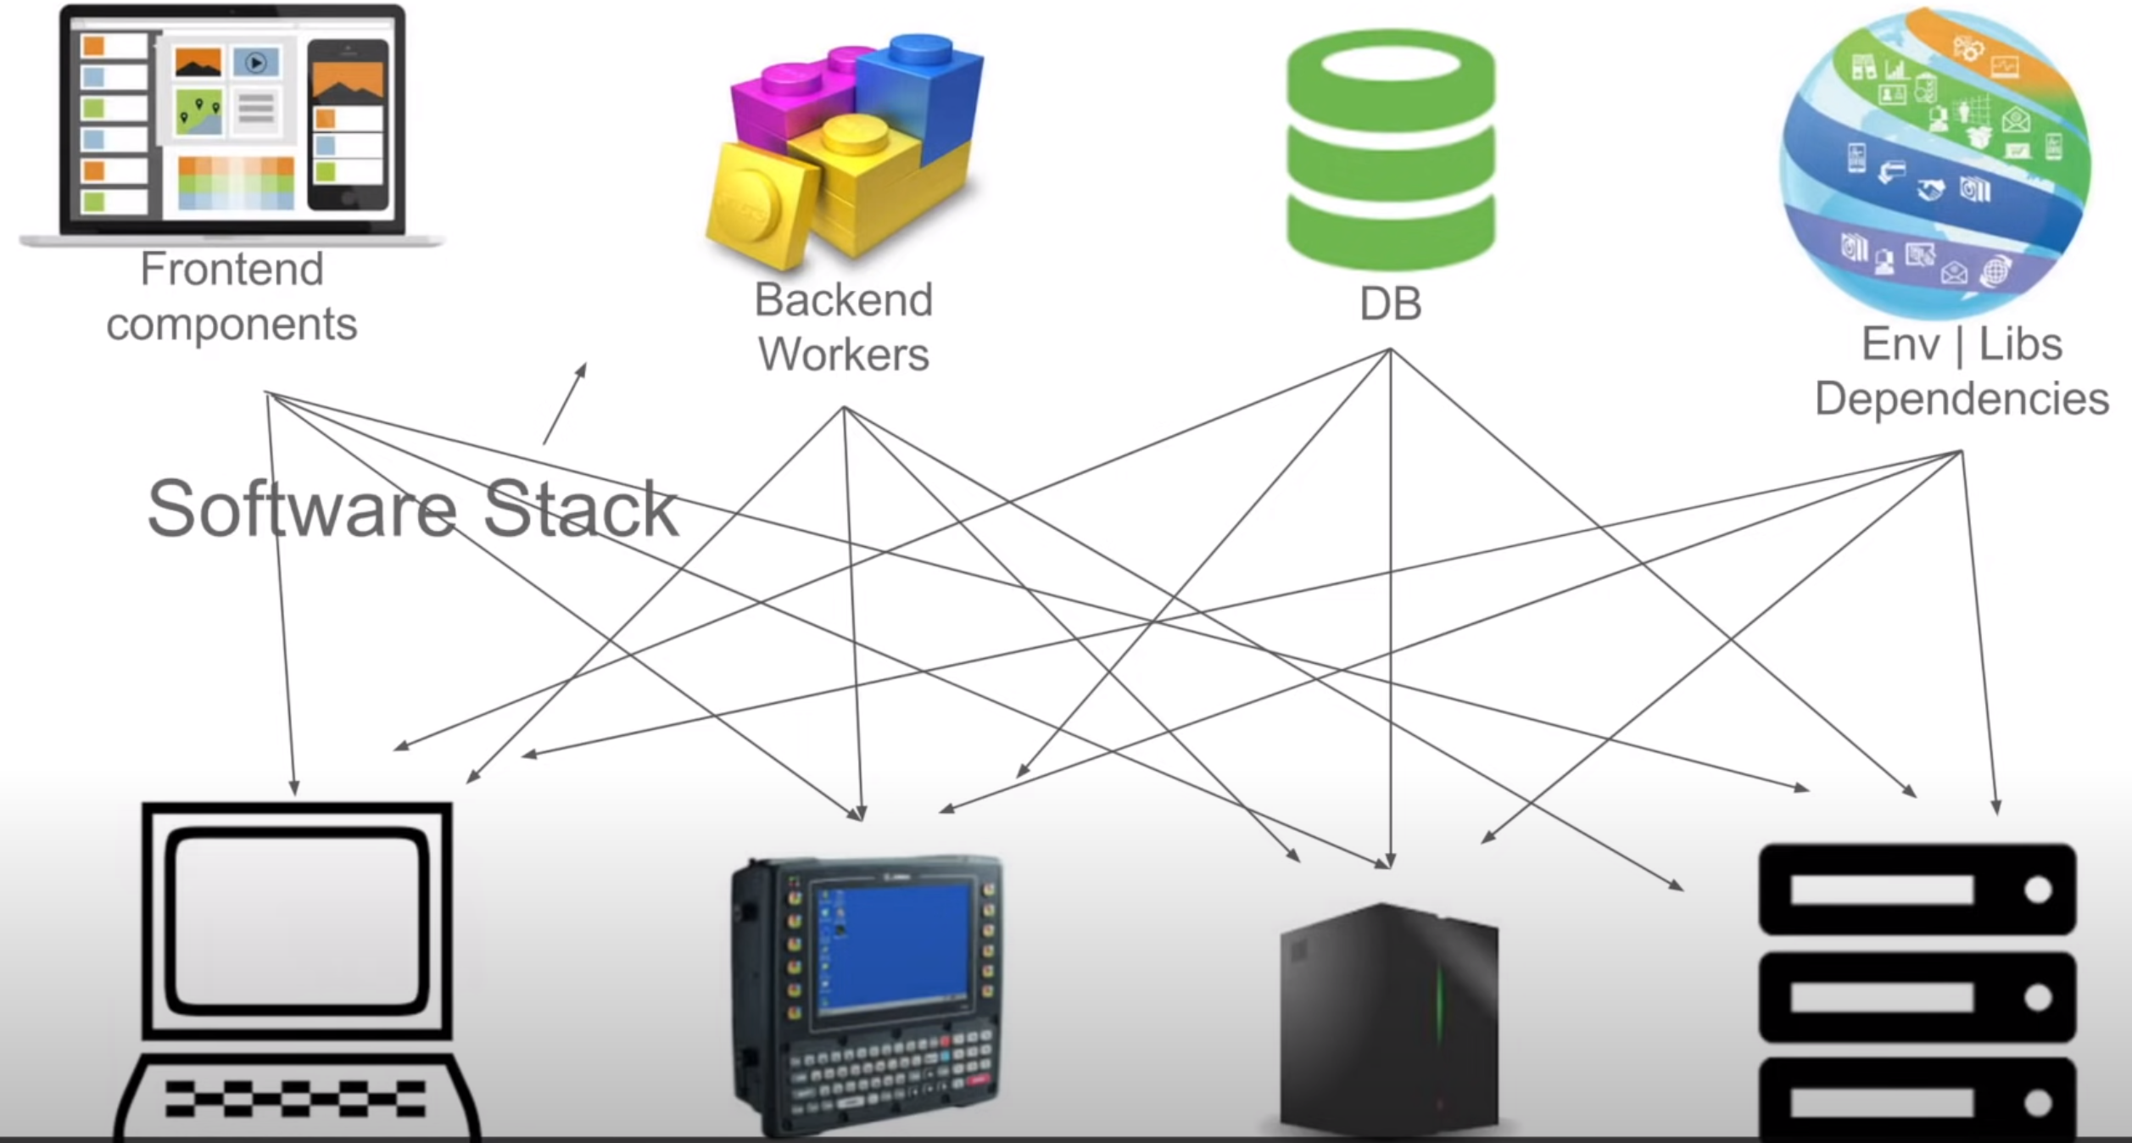

Slide 4
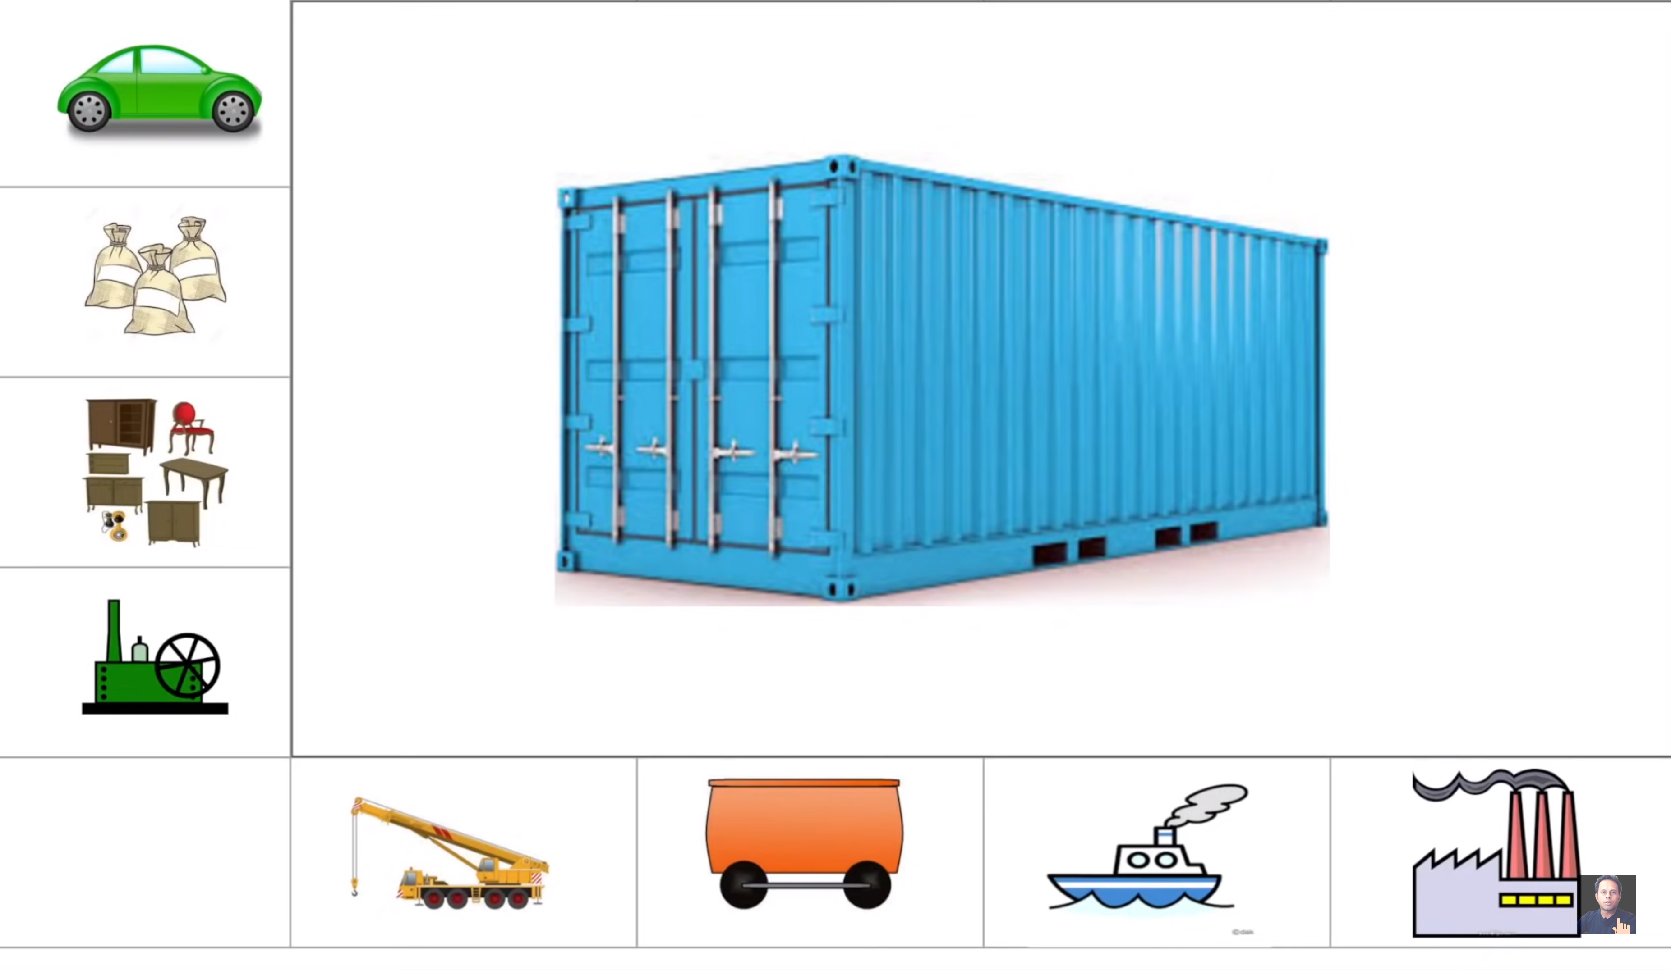

Slide 5
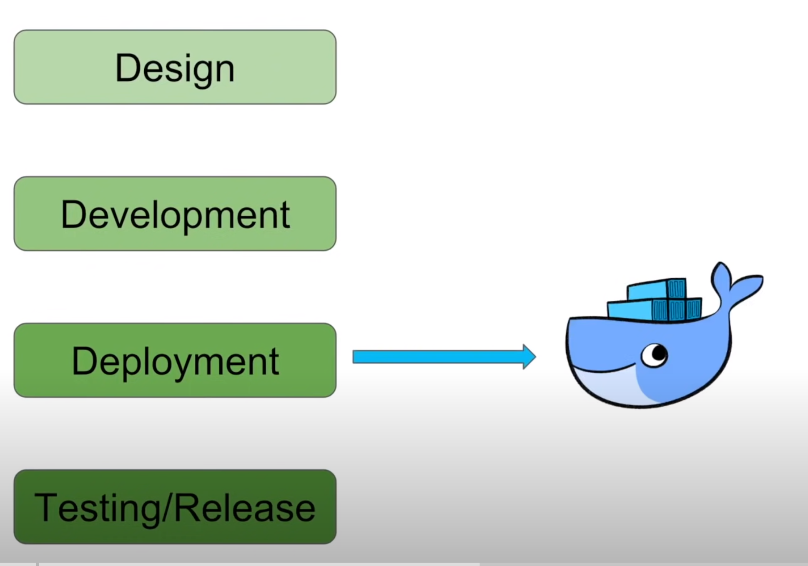

Slide 6
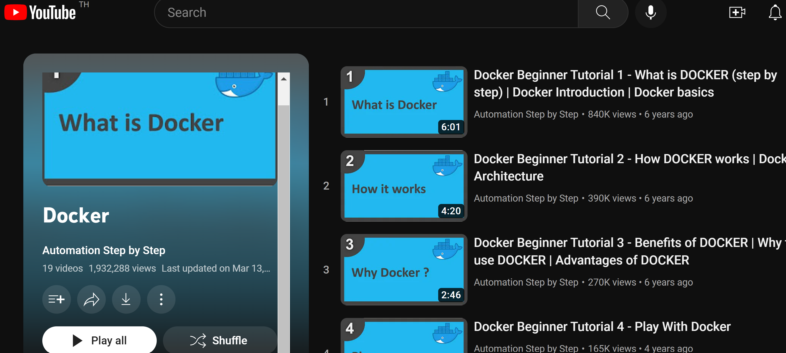
https://www.youtube.com/playlist?list=PLhW3qG5bs-L99pQsZ74f-LC-tOEsBp2rK

Slide 7
10. Docker Playground
https://labs.play-with-docker.com/
https://hub.docker.com/

Slide 8
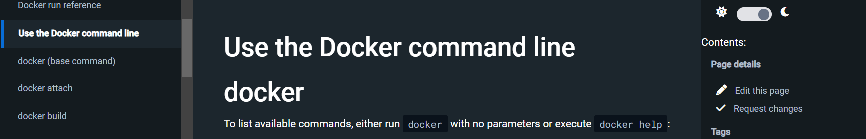
https://docs.docker.com/engine/reference/commandline/cli/

Slide 9
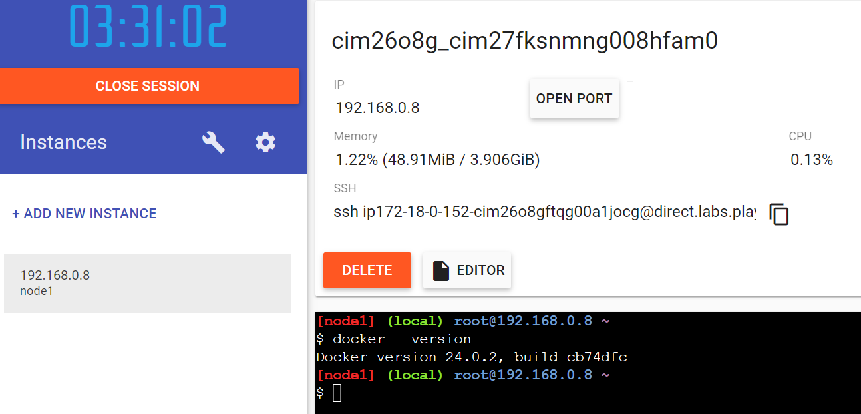

Slide 10
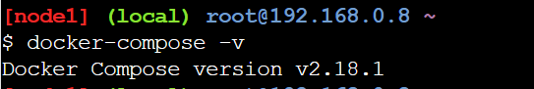

Slide 11
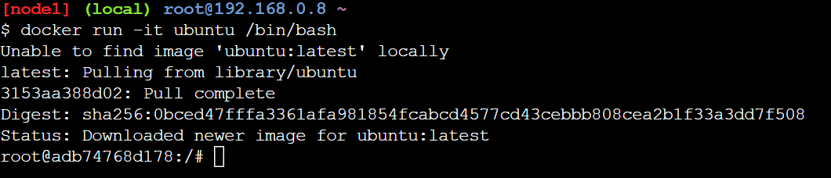
Learn Docker with docker Playground
https://www.youtube.com/playlist?list=PLRnkc1xoj4sonKYywJGTvJ7QA6VVrXgJc

Slide 12
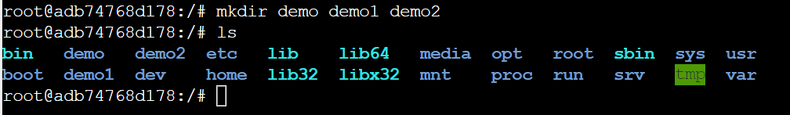

Slide 13
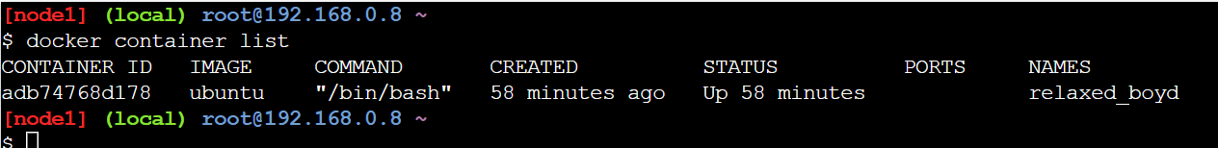
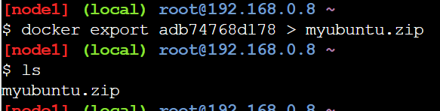
Ctrl – p - q
To exit but keep the container
To hare this container --- make it zip

Slide 14
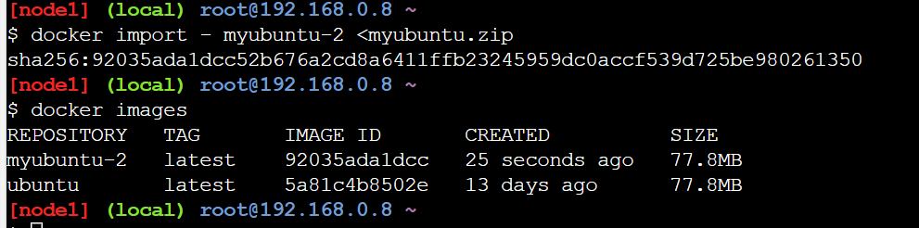
Share this zip file with others
?????
https://www.youtube.com/watch?v=icFf40vB1WI&list=PLRnkc1xoj4sonKYywJGTvJ7QA6VVrXgJc&index=3

Slide 16
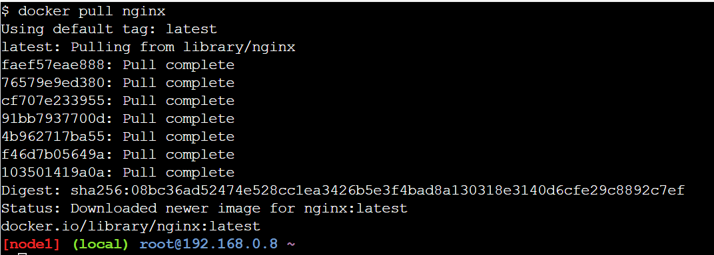
Docker pull -- download

Slide 17
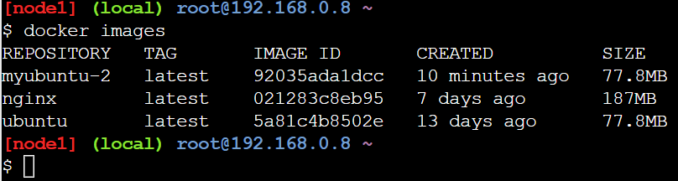
List all images that was download

Slide 18
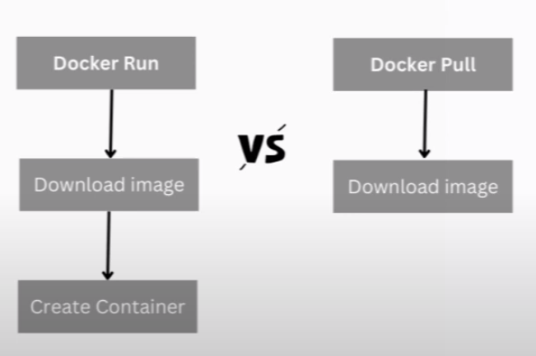
Learn Docker with docker Playground

Slide 19
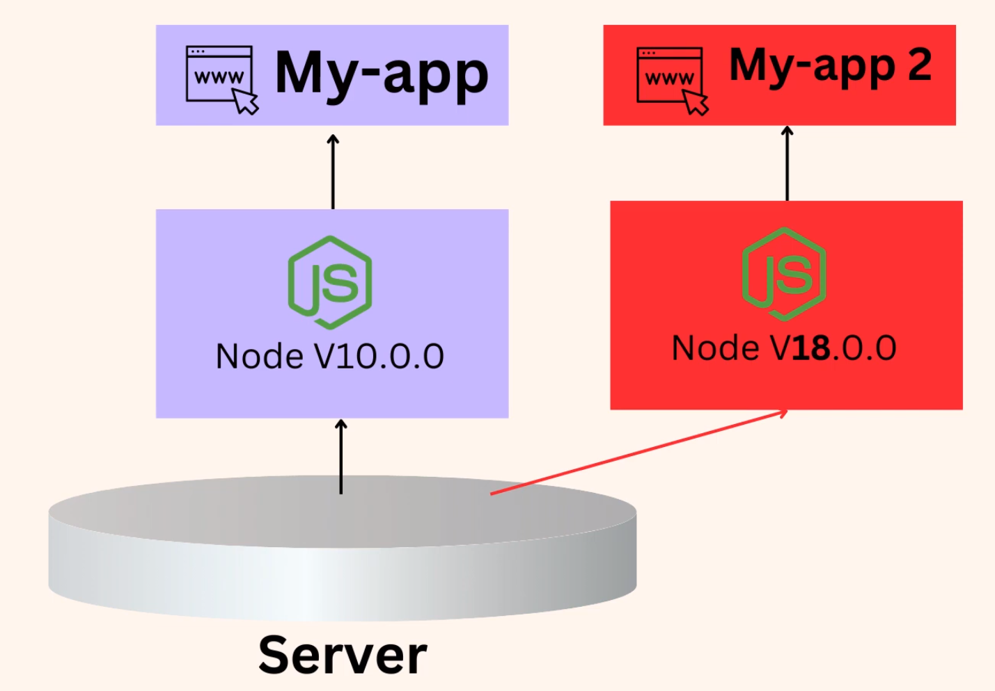
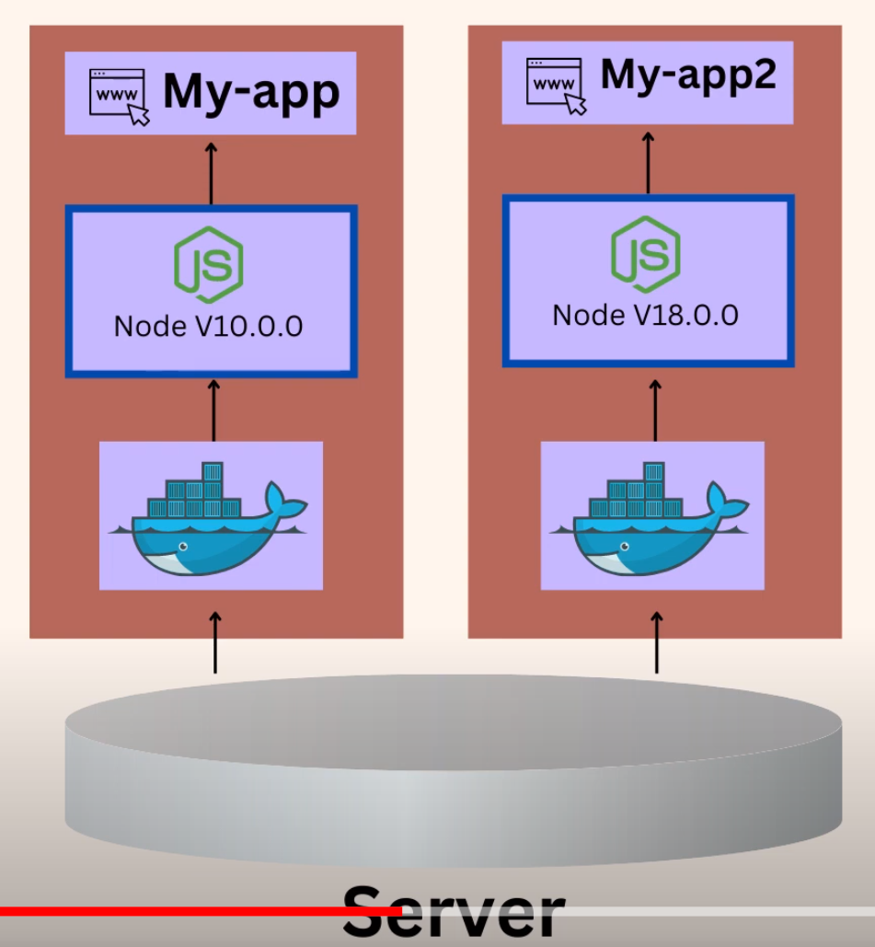
Learn Docker with docker Playground

Slide 20
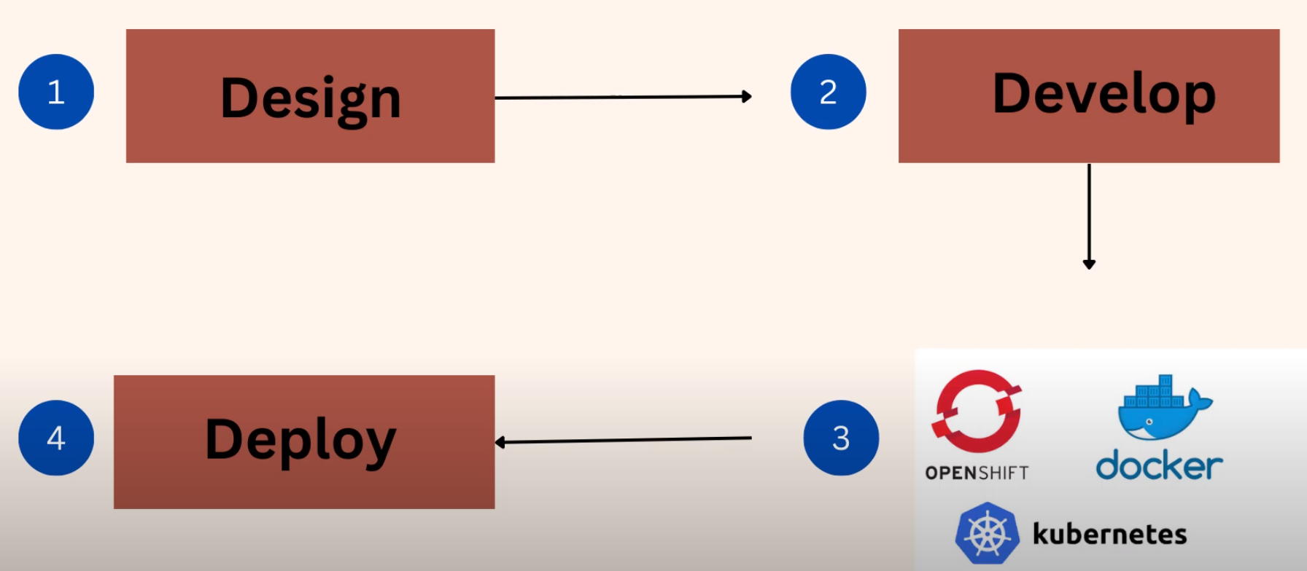
Learn Docker with docker Playground

Slide 21
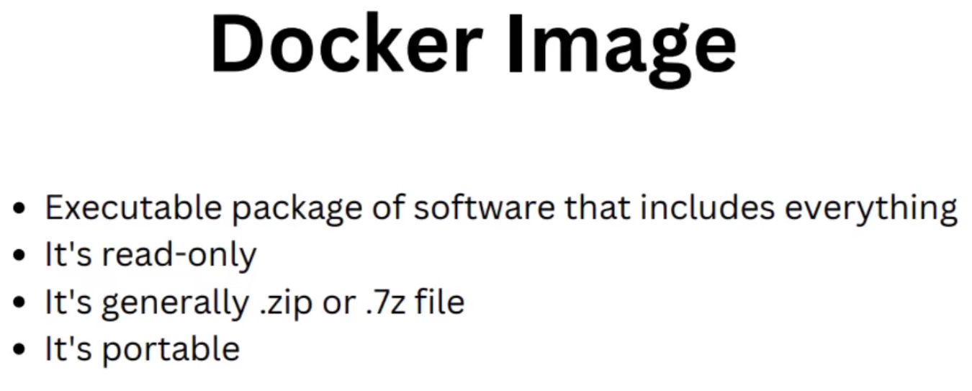
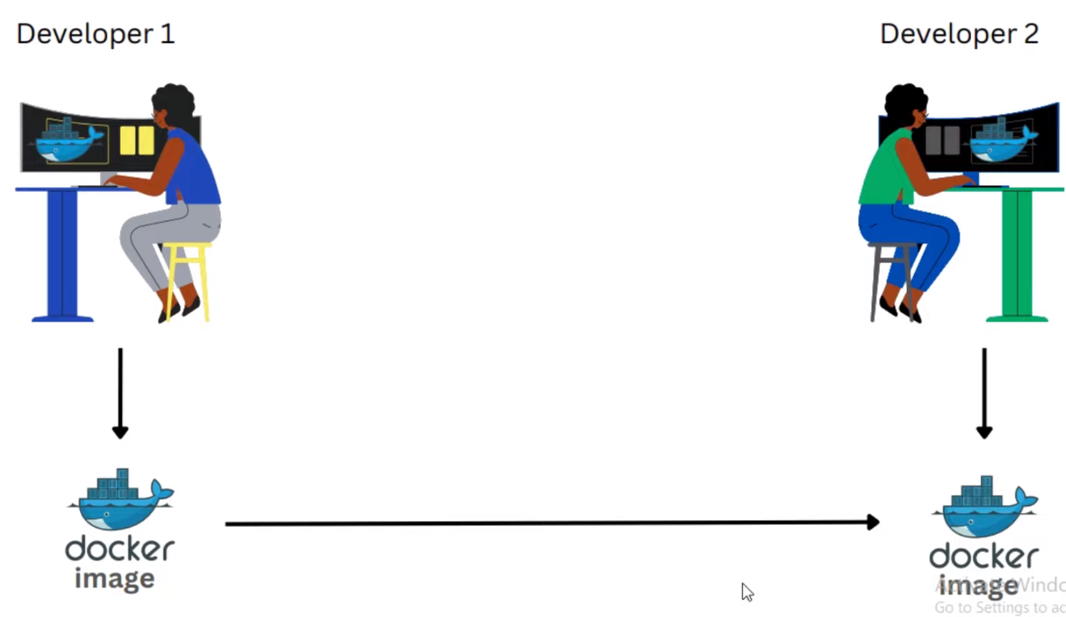
Learn Docker with docker Playground

Slide 22
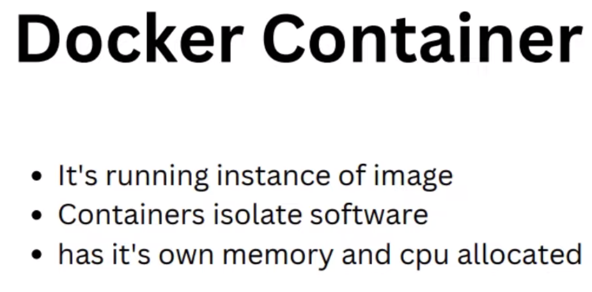
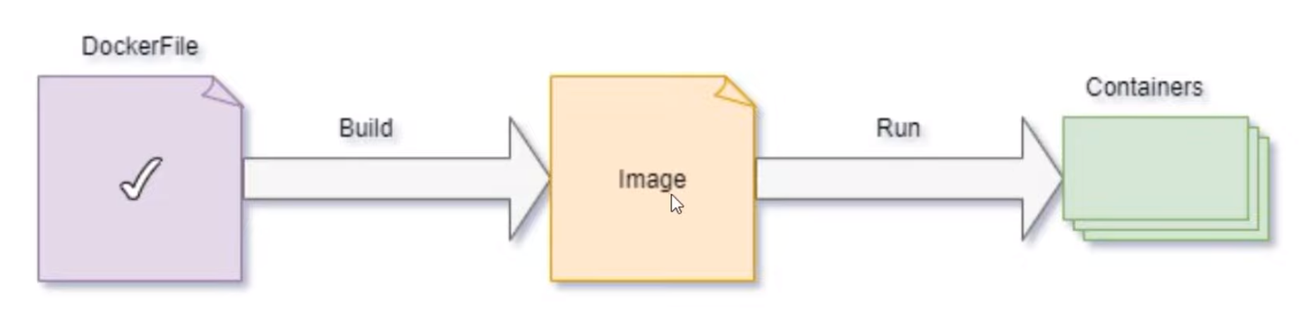
Learn Docker with docker Playground

Slide 24
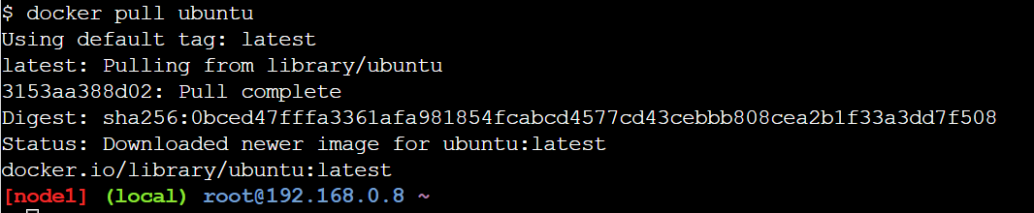

Slide 25
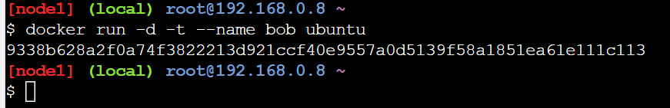

Slide 26
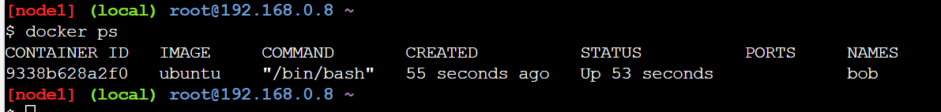
Docker instances

Slide 27
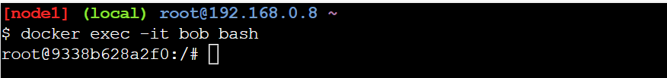
Bash commands

Slide 28
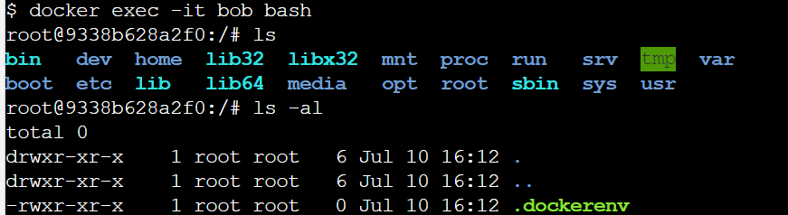

Slide 29
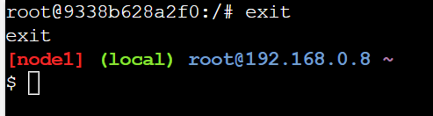

Slide 30
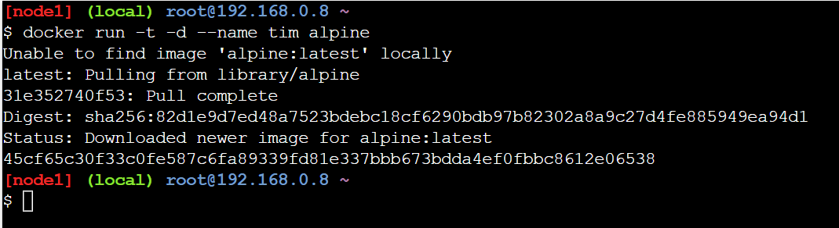

Slide 31
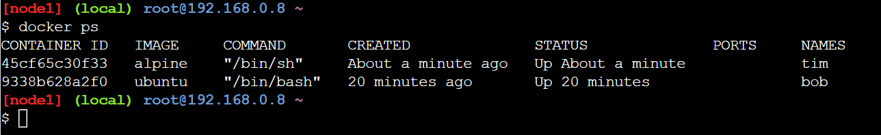

Slide 32
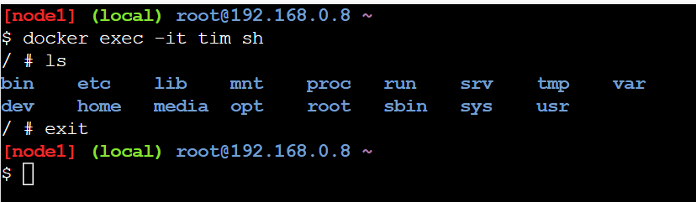

Slide 33

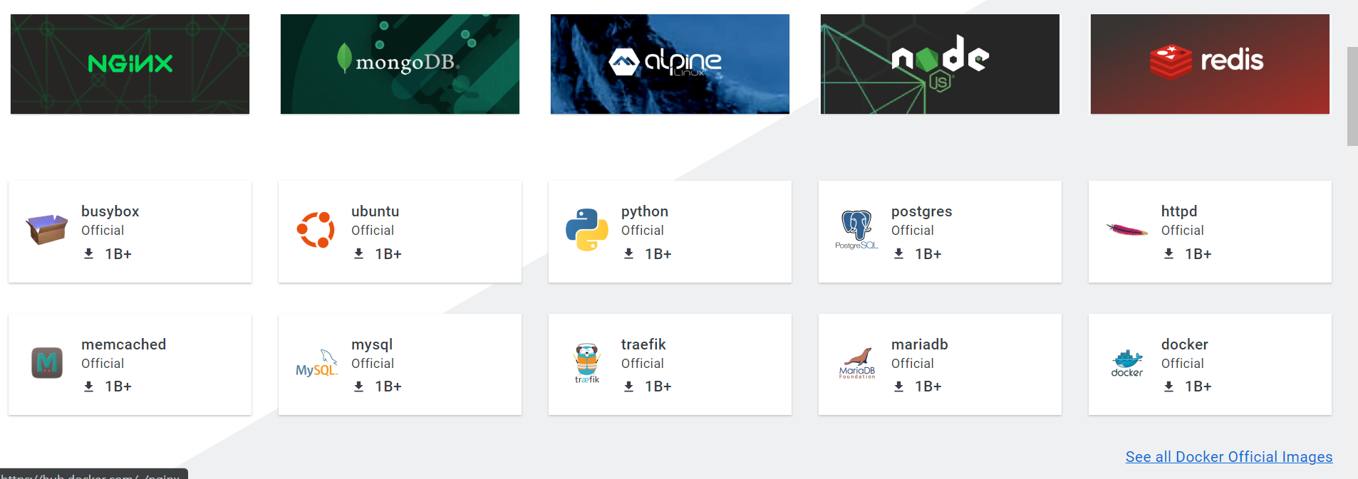
https://www.docker.com/products/docker-hub/

Slide 34
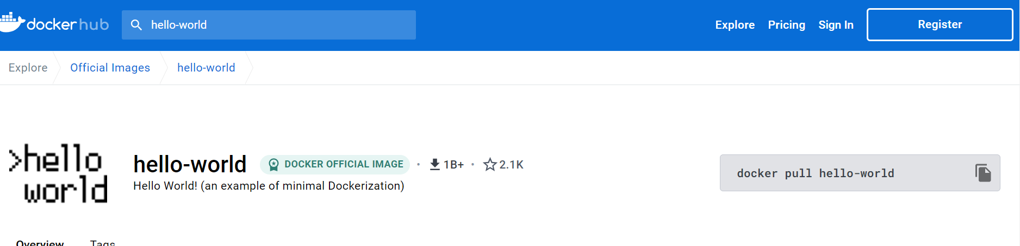

Slide 35
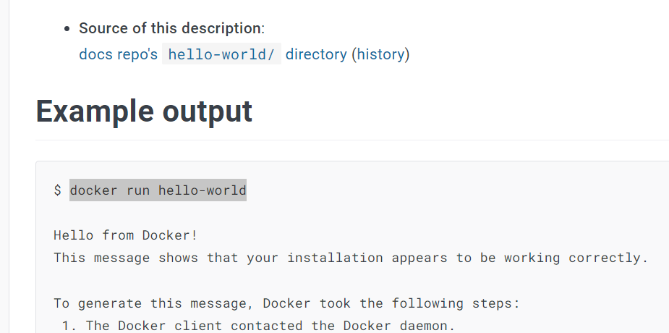

Slide 36
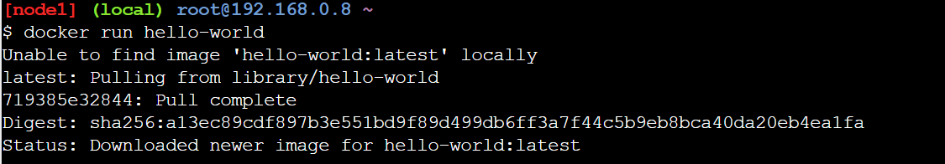

Slide 37
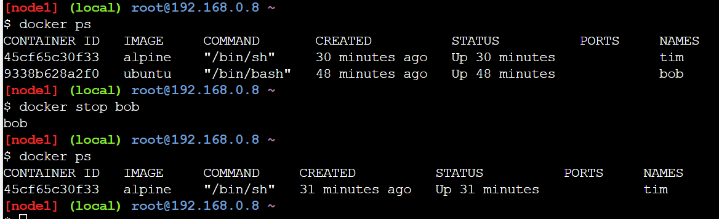

Slide 38
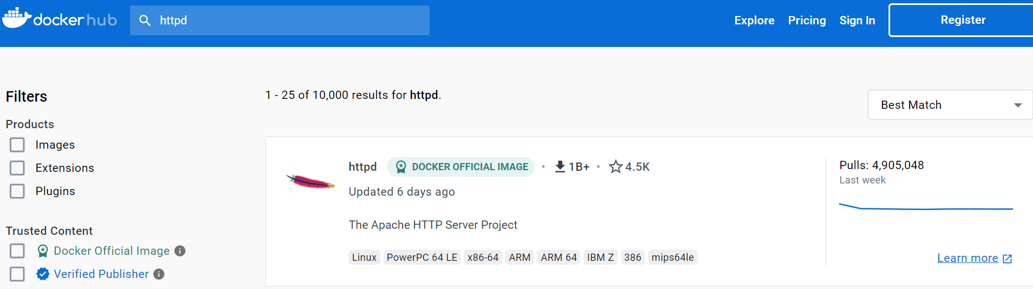
Web server

Slide 39
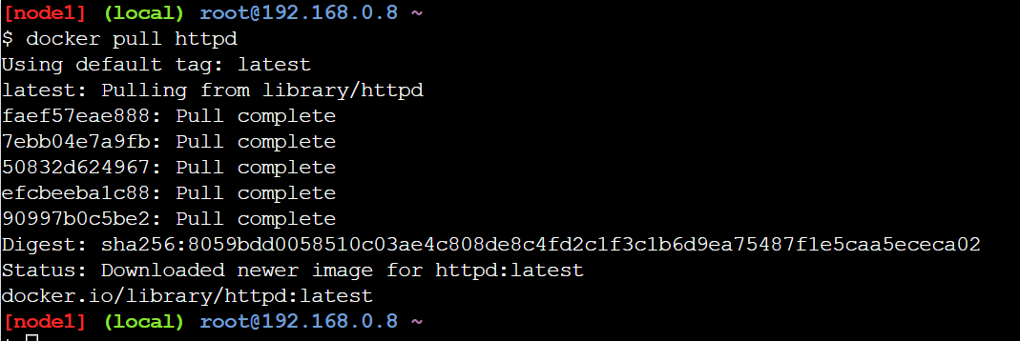

Slide 40
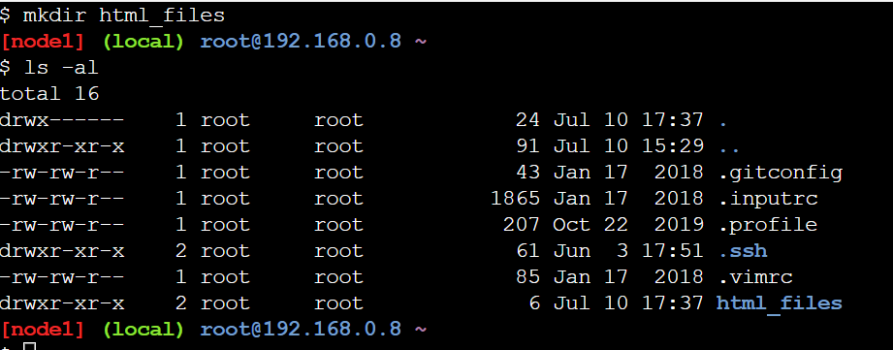

Slide 42
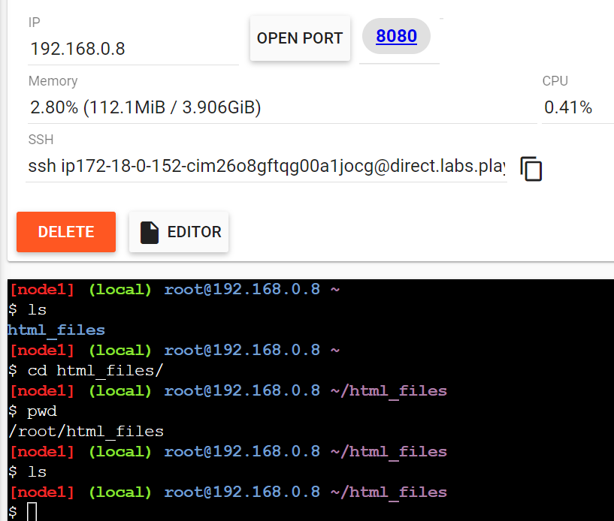

Slide 43
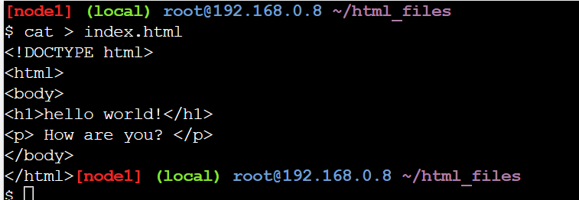
ctrl - D

Slide 44
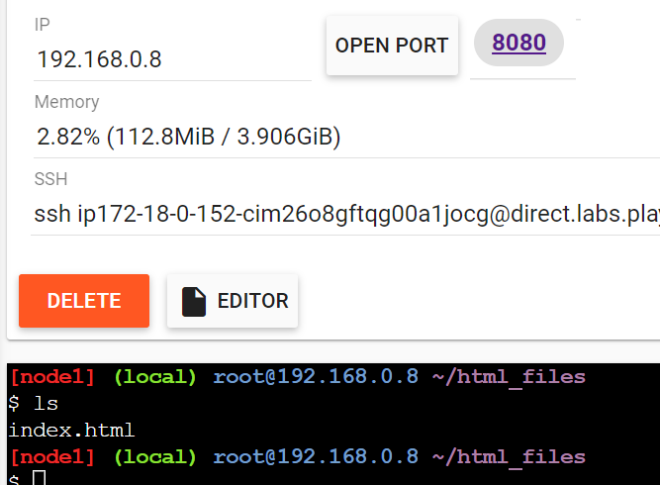

Slide 45
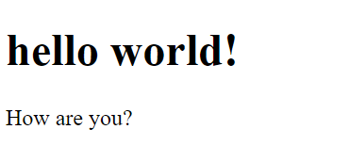

Slide 46
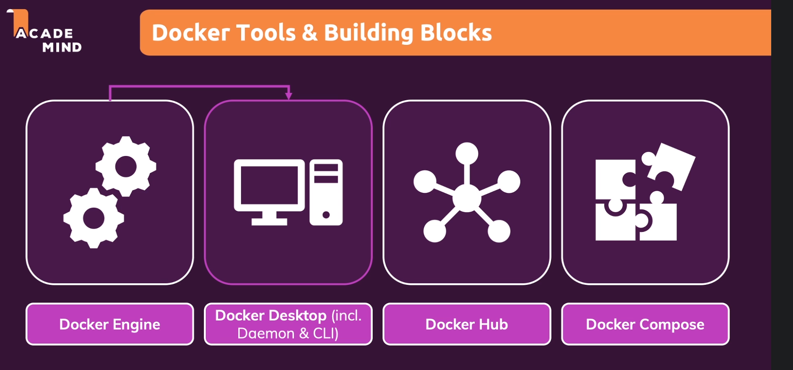
11. An Overview of the Docker Tools

Slide 47
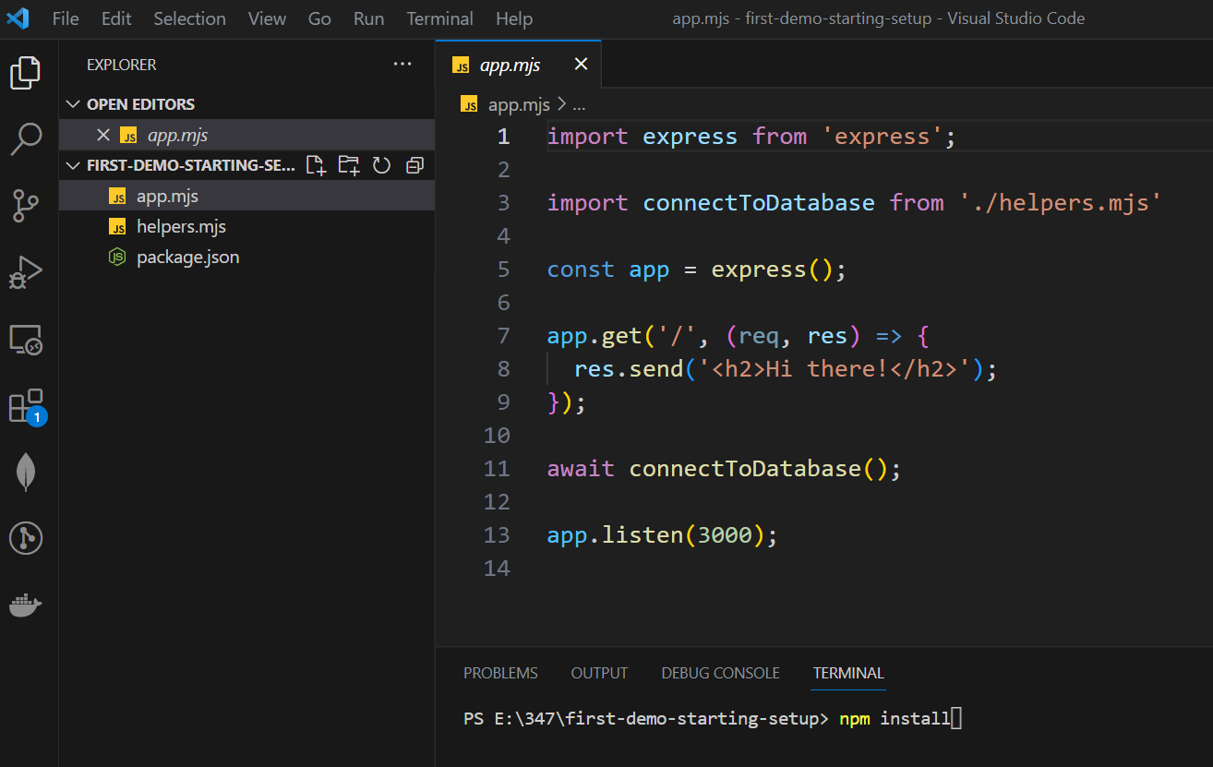
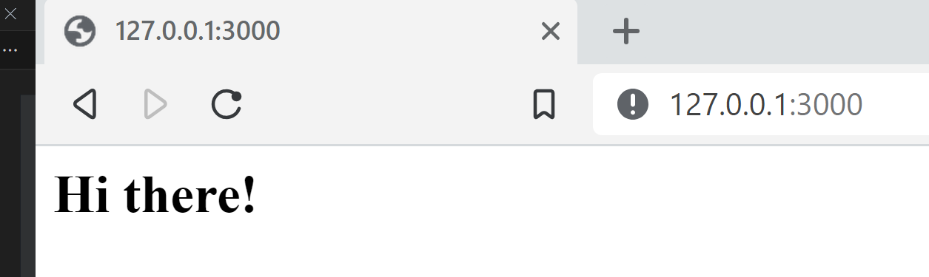
Run code locally
Terminal - new terminal
PS E:\347\first-demo-starting-setup> npm install
PS E:\347\first-demo-starting-setup> node app.mjs
13

Slide 48
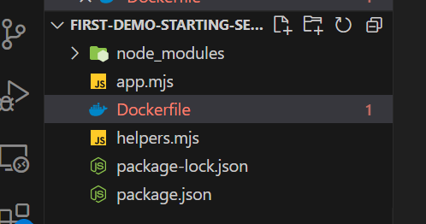
Run code in container
FROM node:14
WORKDIR /app
COPY package.json .
RUN npm install
COPY . .
EXPOSE 3000
CMD ["node", "app.mjs"]
Create Dockerfie
13

Slide 49
Build image
PS E:\347\first-demo-starting-setup> docker build .
Image id
13

Slide 50
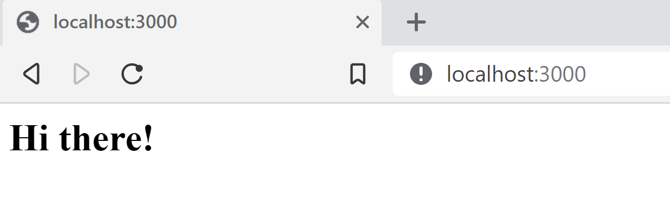
Run image
PS E:\347\first-demo-starting-setup> docker run -p 3000:3000 24f8c8584b0534fd55d500ff87629faa6b1cd9072a9870f73ade899f226df256

Slide 51
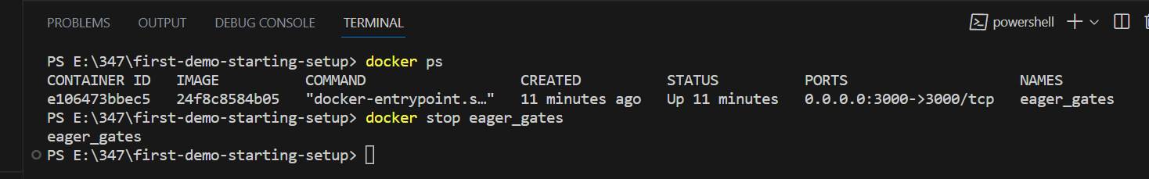
Stop and shutdown container
PS E:\347\first-demo-starting-setup> docker ps
CONTAINER ID IMAGE COMMAND CREATED STATUS PORTS NAMES
e106473bbec5 24f8c8584b05 "docker-entrypoint.s…" 11 minutes ago Up 11 minutes 0.0.0.0:3000->3000/tcp eager_gates
PS E:\347\first-demo-starting-setup> docker stop eager_gates
eager_gates
13

Slide 53

8 Basic Docker Commands || Docker Tutorial 4
https://www.youtube.com/watch?v=xGn7cFR3ARU

Slide 54

See all images

Slide 55



Slide 56


Slide 57

https://hub.docker.com/search?q=redis

Slide 58
download
https://hub.docker.com/search?q=redis

Slide 59

Download redis

Slide 60

not in container yet

Slide 61

Run a container in attach mode
Start Redis image in container

Slide 62


Slide 63

ctrl – c
To stop running container

Slide 64

No container is running

Slide 65

Run container in a detached mode
Run in detached mode
Docker can run your container in detached mode, that is in the background. To do this, we can use the --detach or -d for short. Docker will start your container the same as before but this time will “detach” from the container and return you to the terminal prompt.

Slide 66

https://www.freecodecamp.org/news/docker-detached-mode-explained/

Slide 67

Stop start containr

Slide 68

See container both running and not running

